Slide 1
Game development 2b
State Machines and the State Pattern

Slide 2

State machines
State Machines are structures that control the internal state of an objects
These states can be triggered in a number of ways
Usually, states move to other states from their current state based on criteria
States can also be triggered by certain criteria being met, collisions etc.

Slide 3
Traditional state machines
State machines can be described by the use of an enumeration or collection of states, like in an enum
As such, the current state is represented as one of the states in the enumeration
States executions can then be controlled by a switch statement
Each state will usually have some low level command that occurs in the execution of that state

Slide 4
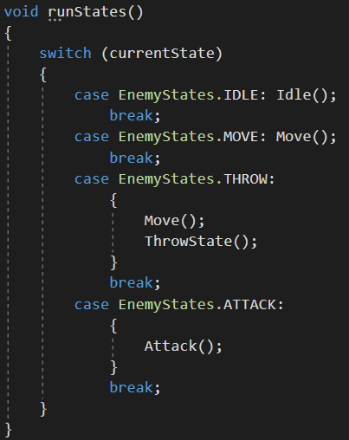
Traditional state machines

Slide 5
Problems with switch-based approach
As always, these traditional state machines means that integral state machine code needs to be changed if we need to add new states
We will always have to do SOME sort of editing when adding new states to a state machine
We will have to deal with circumstances that move the old states into the new state
The State Machine Pattern minimises the amount of changes we need to make

Slide 6
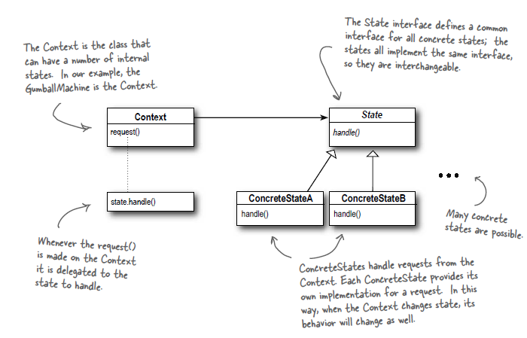
The state machine pattern
Request calls state.handle()
What other pattern does this structure use inherently via the use of delegation?

Slide 7
State and strategy
The class diagram for State and Strategy look similar
Context has an object which delegates its responsibilities to some concrete object
Intention of patterns differ
Strategy is about creating different strategies and objects
State is about making conditionals easier – instead of having multiple conditionals to decide a course of action, you can just change state

Slide 8
transitions
State to State: State determines how to move to another state
1
State Machine: Globally, the state machine can continue checking for some sort of trigger than can move between states
2
You will always have to dig back into either of these when integrating a new state
3
Makes fewer changes
4
Having state changes in the State Machine itself makes the State classes less dependant on each other, which makes it more ideal
5

Slide 9
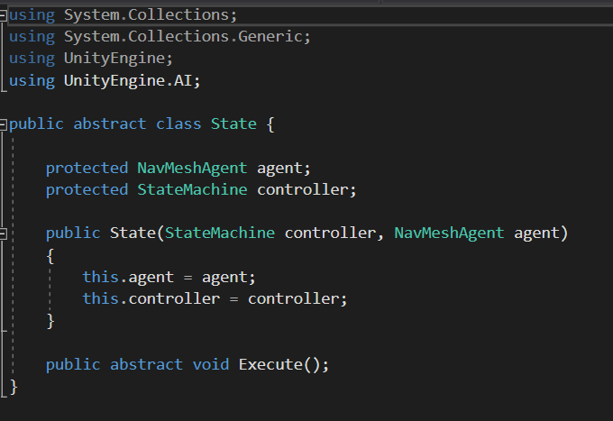
structure
Our State needs access to its StateMachine if we have inter-state changes. If the State Machine class handles all our changes, we don’t need it
In this case we also need our agent because some/all of our states will affect the agent’s behaviour

Slide 10
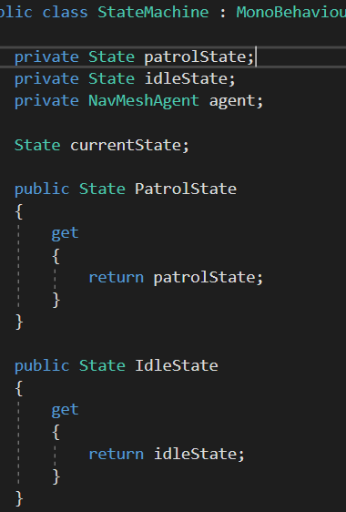
Setting up the state machine
We need State placeholders for each state
We instantiate each State on state machine creation
We change state to the placeholders
Why this instead of currentState = new PatrolState()?
Accessors only exist for interstate changes

Slide 11
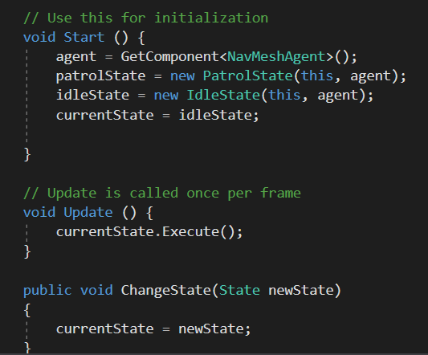
The ease of a state machine

Slide 12
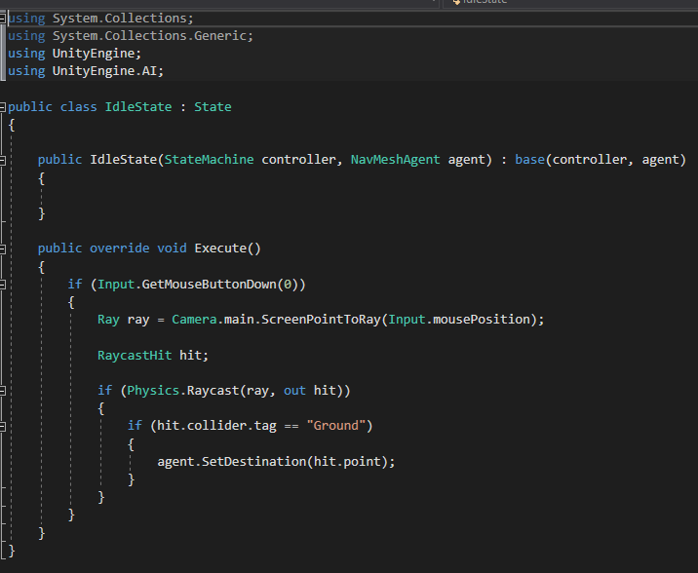
The states - idle
In this case, just a carbon copy of existing functionality
“Idle” in this case is user-controllable

Slide 13
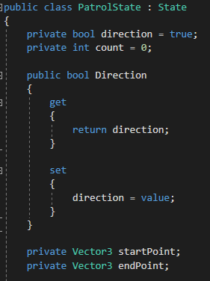
The states - patrol
Boolean to handle destination (forward or backward)
Counter to handle state change – this is not ideal. We’ll change this later

Slide 14
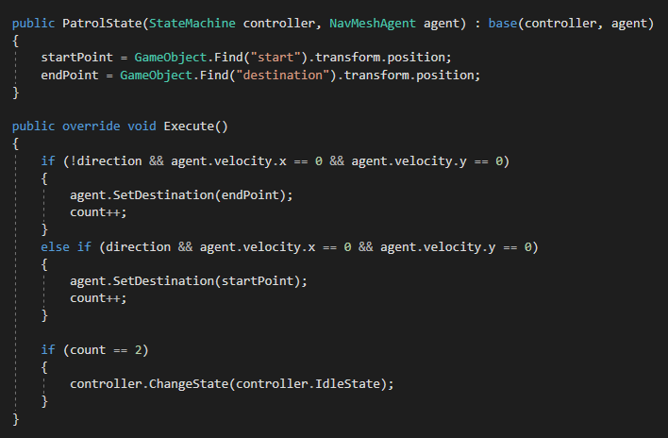
The states - patrol

Slide 15
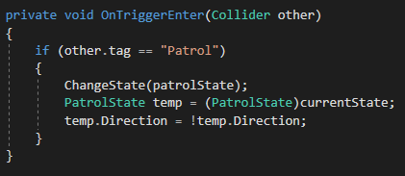
Coding state changes into the state machine
The State Machine itself will have to deal with changes
How you deal with changes will be dependant on your application
You should either entirely control your states via State to State or via State Machine
Not both
We have to cast here because we need to edit things in the patrol state when we hit a patrol tag
Your application may not be like this

Slide 16
Fixing the dependencies

